Slide 1

TEAM 4
EMPOWERING HEALTH SYSTEMS: ONLINE MEDICAL CONSULTATION DATABASE

Slide 2


AGENDA OF THE PRESENTATION
Why medical online consultation database?
Business Problems
Business rules with ERD
SQL Queries
Visualisations
Conclusion & Future works

Slide 3






OUR TEAM
Jessica Anna James
Shubham Gaur
Jaamie Maarsh
Anjali Haryani
Kalyan Kumar

Slide 4

WHY THIS ?
Meeting rising demand for efficient and accessible medical services.
Online consultations minimize physical contact, decreasing infection transmission Post Covid-19.
Comprehensive electronic medical record management provided.
Seamless feedback collection and processing facilitated.
Patient data stored in the database can be leveraged for predictive analytics.

Slide 5
BUSINESS PROBLEMS ADDRESSED ?
Facilitate remote medical consultations.
Online diagnosis service
Streamline appointment scheduling.
Enhance the evaluation of doctor’s performance.
Maintain data for online medical services.

Slide 6
ERD and its business rules

Slide 7
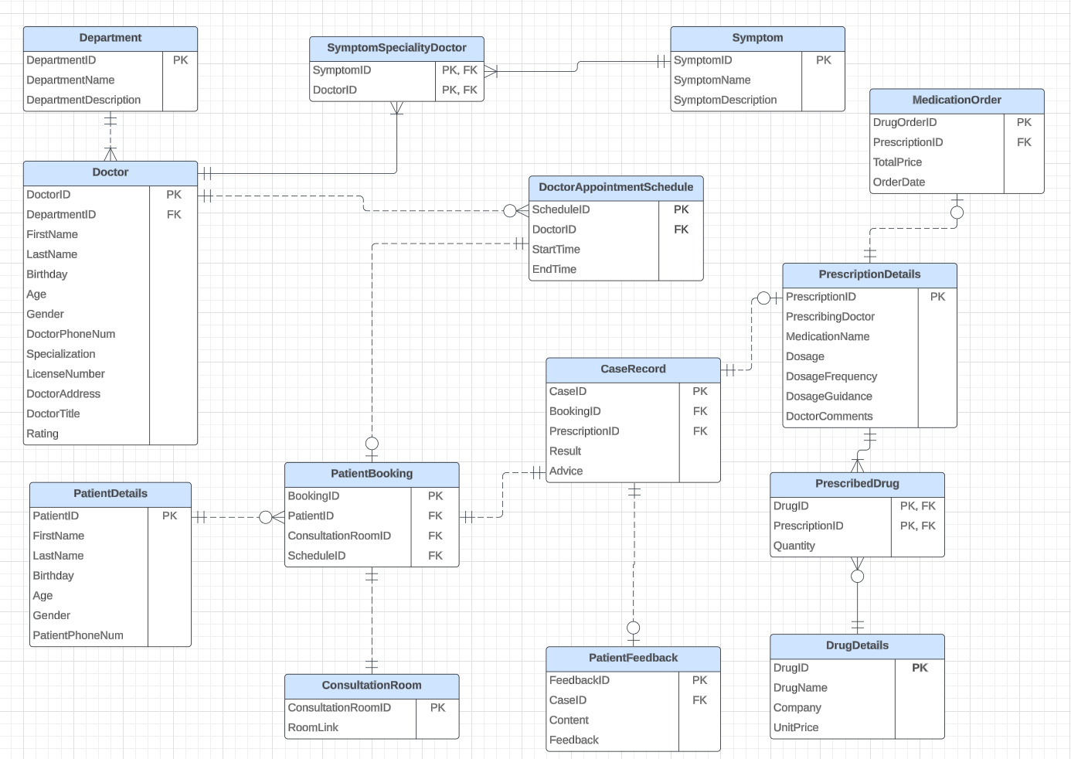
FINALISED RELATIONSHIP DIAGRAM

Slide 8
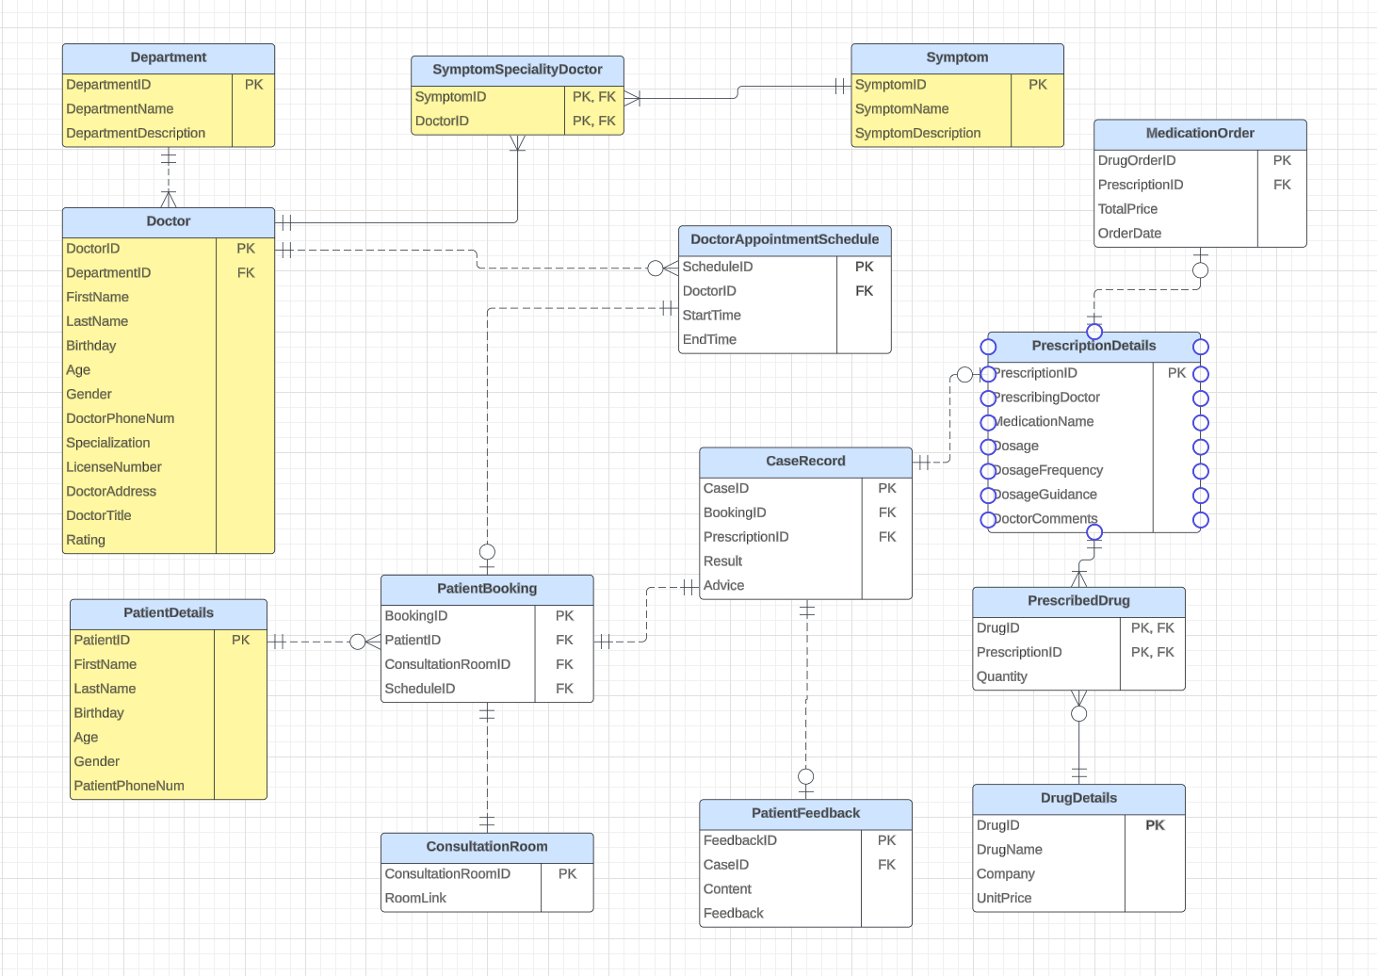
ERD - SECTION 1
BUSINESS RULES
Each department may have one or more doctors.
Each doctor can handle more than one symptom.
Each patient has only one primary phone number (account) stored.

Slide 9
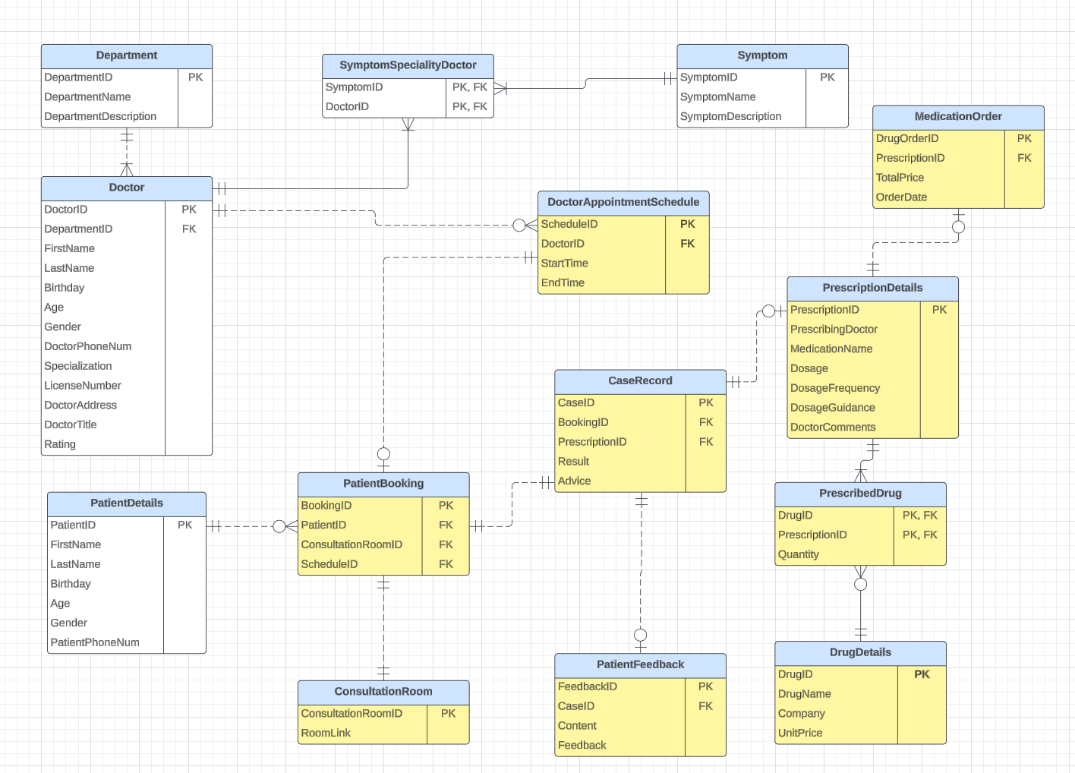
ERD - SECTION 2
BUSINESS RULES
Each patient may have zero or more bookings.
Each doctor may have zero or more doctor schedule.
Each doctor can only treat one patient at a scheduled time slot.
Each booking may have only one case associated with.
Each booking may have only one consultant room associated with.
Each booking may be associated with at most one scheduled time slot.
Each case may be associated with at most one feedback.
Each case may be associated with at most one electronic prescription.
Each electronic prescription may have one or more drug prescribed.
Each electronic prescription may have zero or one drug order.

Slide 10
SQL Queries and Outputs

Slide 11
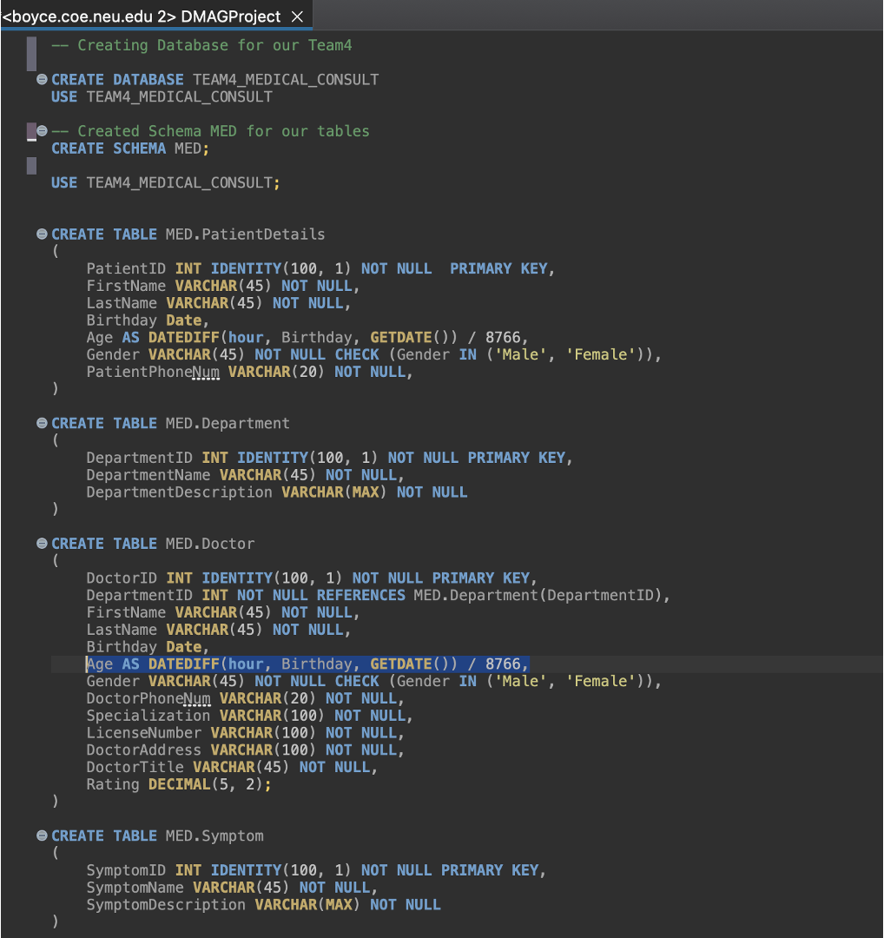
SCHEMA AND DDL
PRIMARY KEY constraints for unique identification
NOT NULL constraints for essential data capture
Calculated age field in PatientDetails and Doctor tables using DATEDIFF function
Enforced data integrity through CHECK constraints for gender fields
Maintaining referential integrity via foreign key relationships

Slide 12
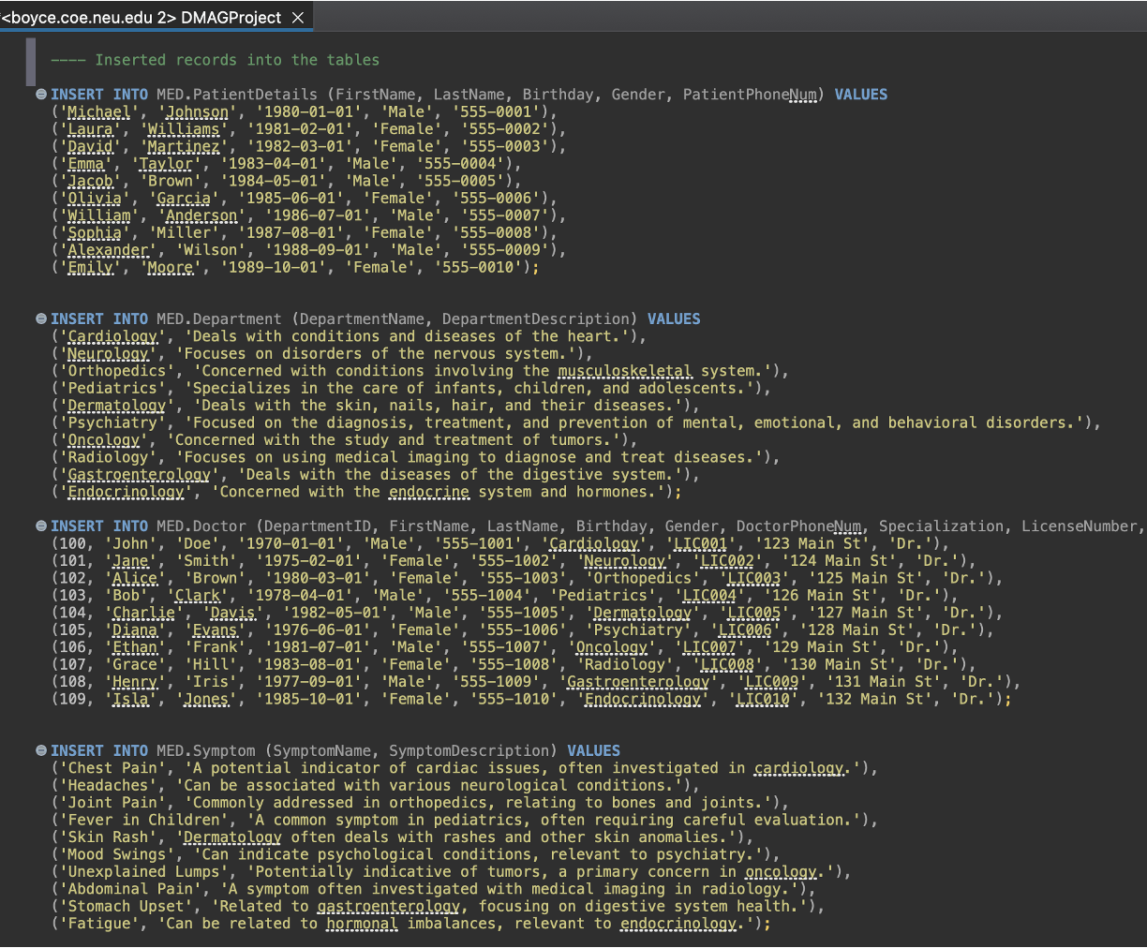
DATA MANIPULATION LANGUAGE (DML)
PatientDetails: Comprehensive demographic data added (names, birthdates, genders, contact info)
Department: Details about medical specializations provided
Doctor: Practitioners linked to respective departments, credentials, contact info added
Symptom: Detailed symptoms and descriptions connected to medical fields
Foundational data insertion for robust, relational medical consultation system
Reflects real-life operations and patient care dynamics

Slide 13
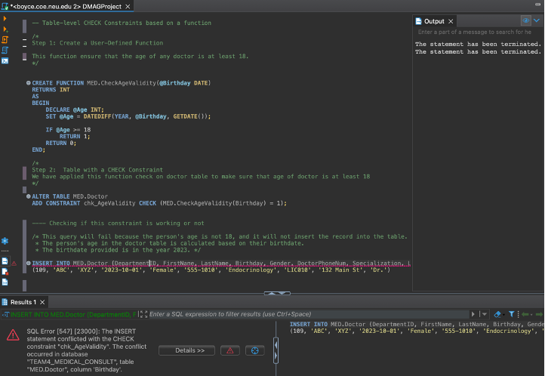
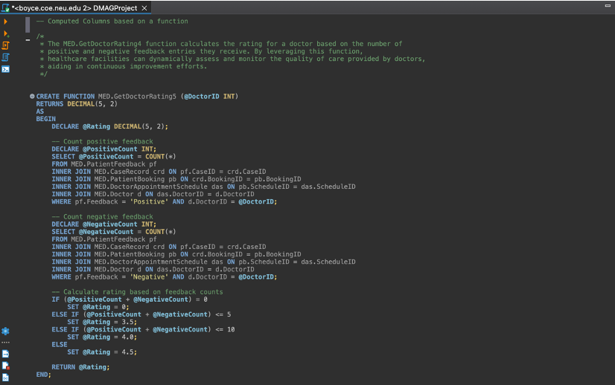
FUNCTIONS AND COMPUTATED COLUMNS
Table-Value CHECK Constraints
In-Line Age constraint
Doctor should be alteast more than 18 years of age
Computed Columns
In-Line Rating Calculator
Using Feedback given by patients

Slide 14
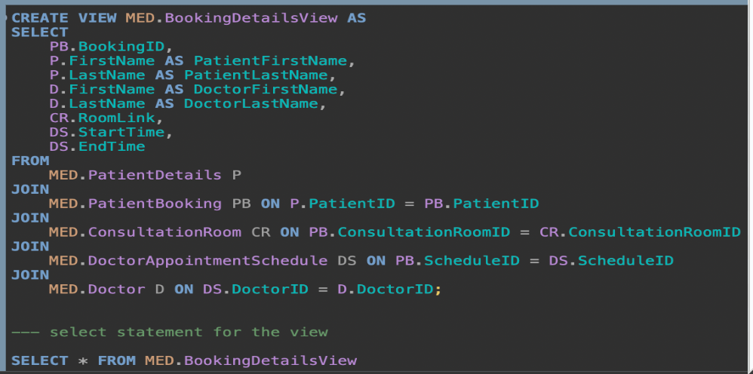
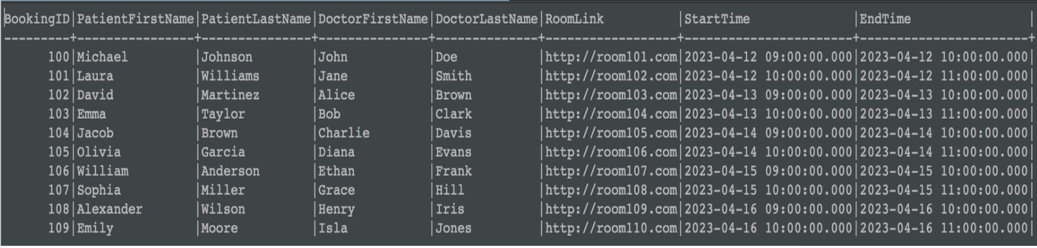
BOOKING DETAILS VIEW
The MED.BookingDetailsView provides a concise summary of patient Details.
It Displays the appointments,including the booking ID, patient's first and last names, doctor's first and last names, consultation room link, and appointment start and end times.

Slide 15
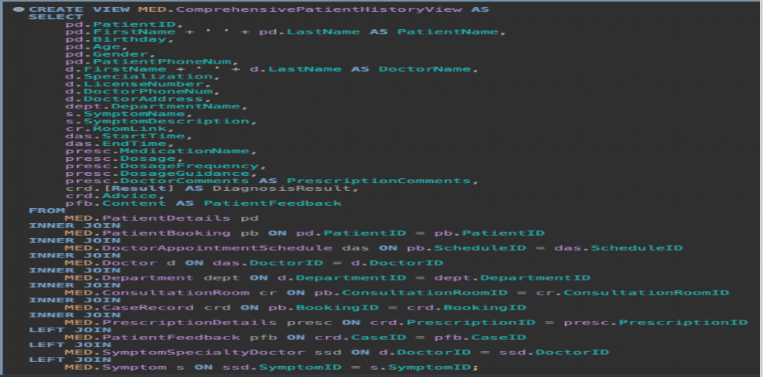
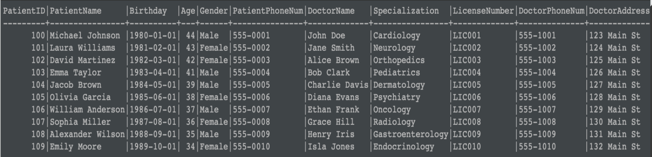
PATIENT HISTORY VIEW
The ComprehensivePatientHistoryView summarizes a patient's medical journey.
It combines information such as patient details, doctor appointments, prescription details, and symptom descriptions into a single comprehensive overview.

Slide 16
Data Visualisations

Slide 17
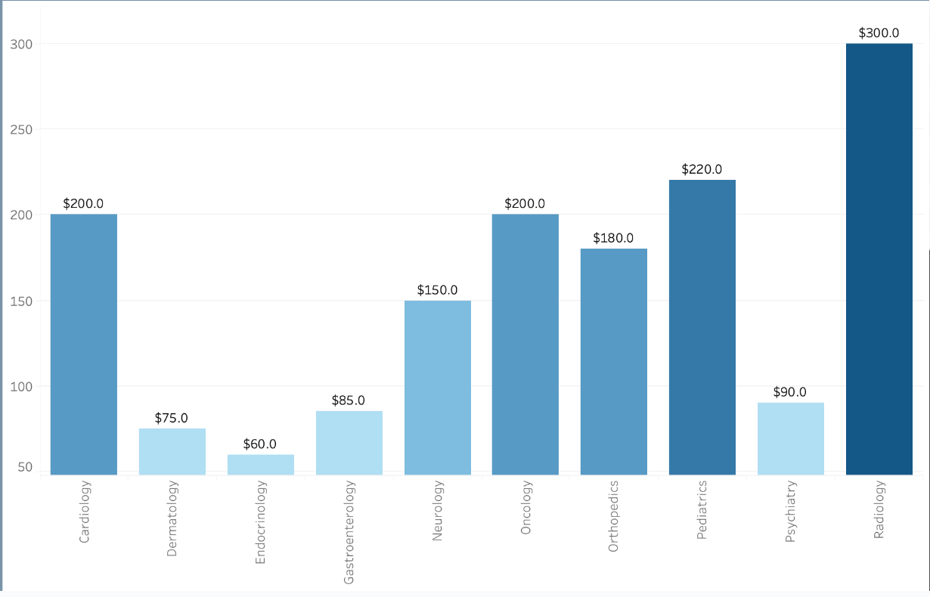
CONSULTATION CHARGE PER VISIT
INSIGHTS
High variation in consultation fees: Radiology most expensive, Endocrinology & Dermatology least. (Reason: equipment, expertise, billing?)
Higher fees in specialties like Radiology & Cardiology may limit access for low-income/underinsured patients, creating healthcare disparities

Slide 18
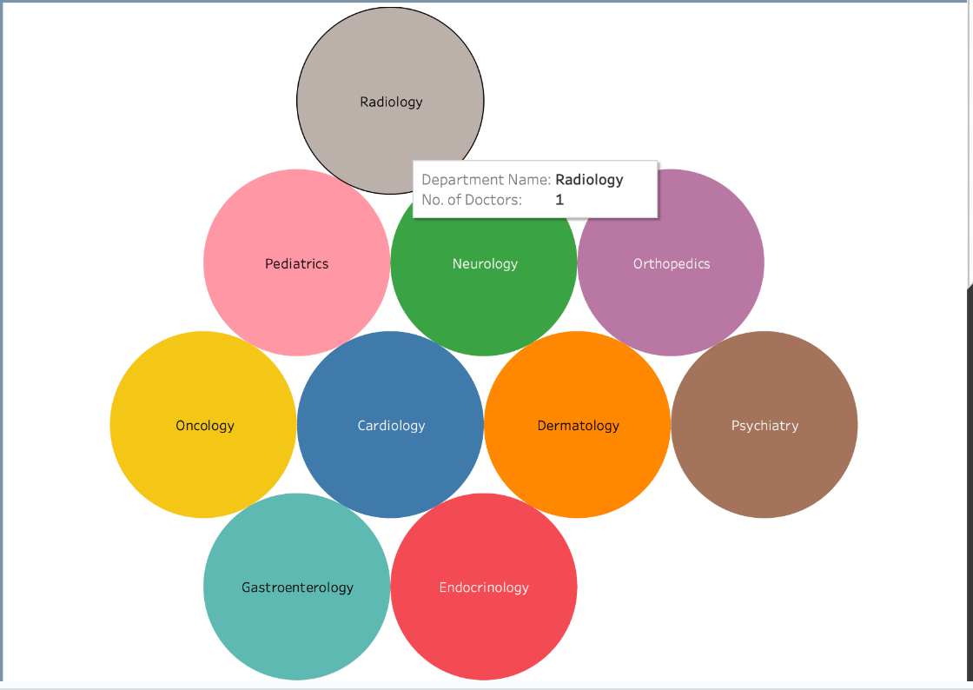
DISTRIBUTION OF DOCTOR'S DEPARTMENTS
INSIGHTS
The chart shows a variety of medical specializations, with none dominating in terms of doctor count.
Circle sizes likely indicate department emphasis, potentially due to resource allocation or patient needs.

Slide 19
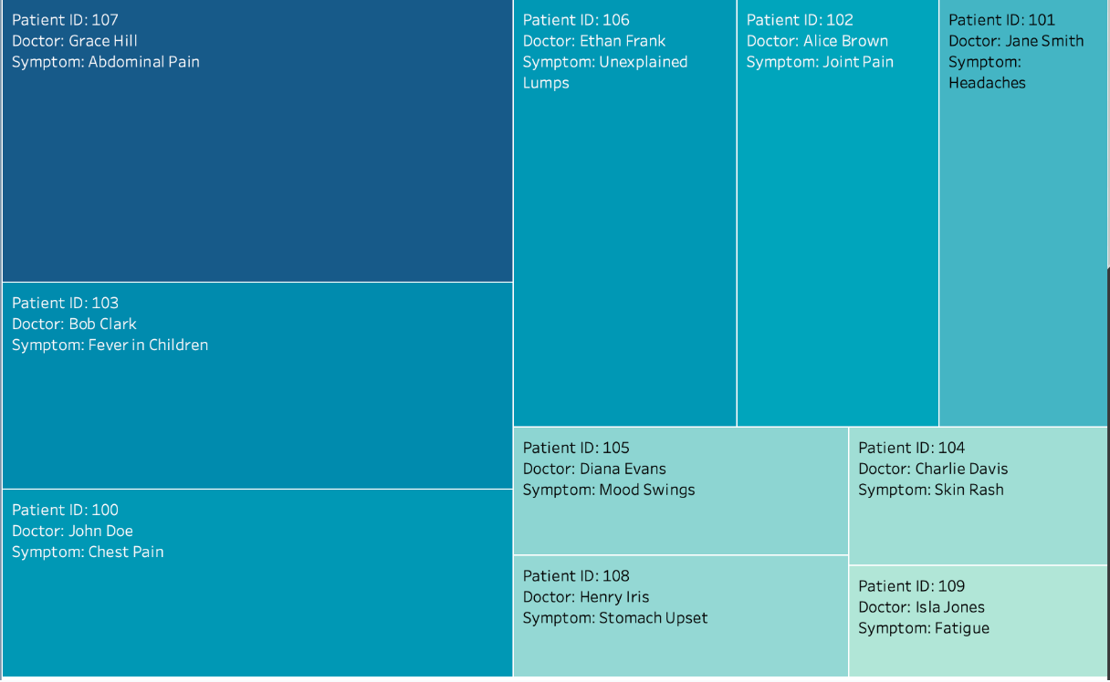
PATIENT SYMPTOM DETAILS ANALYSIS
INSIGHTS
Patients report a wide variety of symptoms, indicating the facility addresses diverse healthcare needs.
Symptom details offer insights into patient needs and potential collaboration between departments.

Slide 20
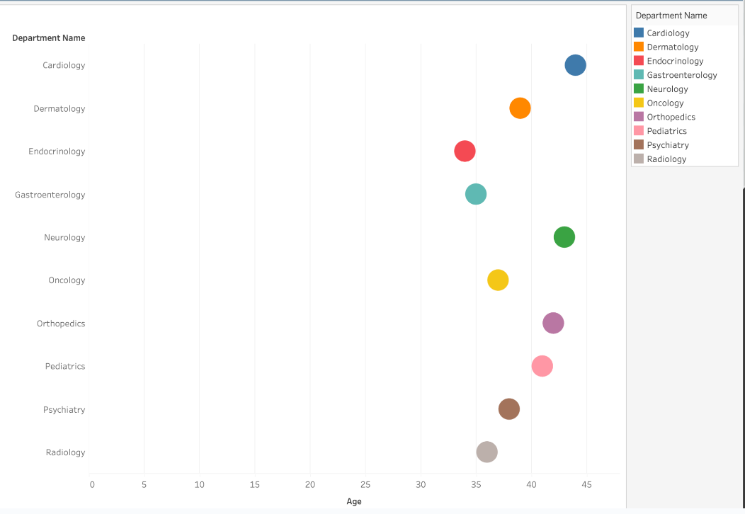
AGE DISTRIBUTION ACROSS MEDICAL SPECIALTIES
INSIGHTS
Wide age range across departments: Pediatrics for younger patients, Orthopedics and Radiology may lean towards older patients.
Age data gaps in some departments (Gastroenterology, Psychiatry) suggest limited samples or data collection issues.

Slide 21


CONCLUSION
Our online medical services' ERD provides a clear blueprint of entity relationships and interactions, which makes data collection and transformation seamlessly easy.
Doctor Rating calculation function provides a concise method for evaluating healthcare providers, ensuring quality patient care.

Slide 22

FUTURE WORK
Expanding the dataset within our database to get more useful insights.
Implementing advanced analytics to derive deeper insights from the patient data.
Strengthen security measures to protect patient data from unauthorized access.

Slide 23


